Slide 1
How Many "Stroad Miles" Does Delaware Have?
Presented By:
David P. Racca
Center for Applied Demography
and Survey Research
University of Delaware
Email: dracca@udel.edu

Slide 2
This talk will include discussion of the stroad concept, how it might be defined, and the location and extent of stroads in Delaware.

Slide 3
A high percentage of fatalities are strung across major arteries where there is high volume, high speed, and multiple lanes. This includes the corridors Route 40, Kirkwood Highway (Route 2), and Concord Pike in New Castle County, Route 13 through City of Dover, and several others.

Slide 4
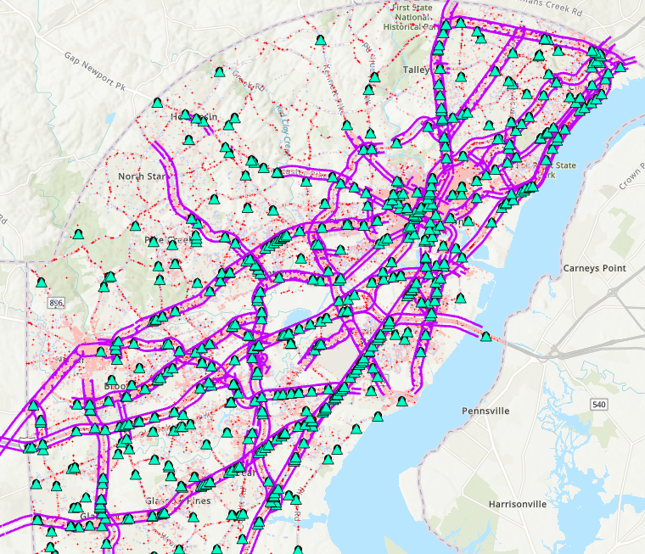
Fatal Crashes Shown With 4 Lane and Above Highways
Crash Data 2009 thru 2020

Slide 5
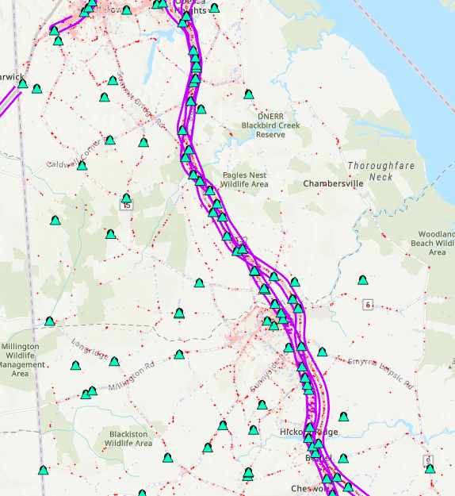
Fatal Crashes Shown With 4 Lane and Above Highways

Slide 6
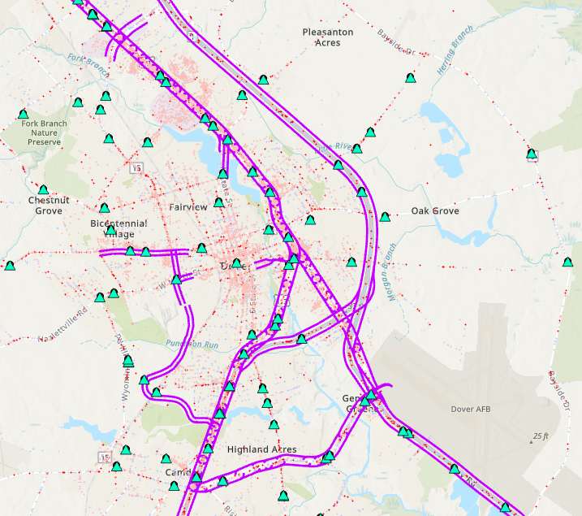
Fatal Crashes Shown With 4 Lane and Above Highways

Slide 7
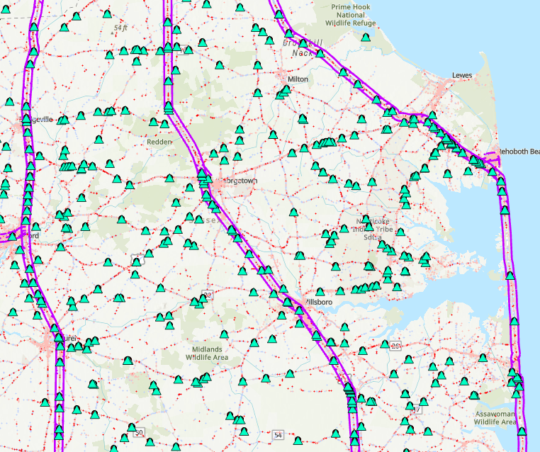
Fatal Crashes Shown With 4 Lane and Above Highways

Slide 8
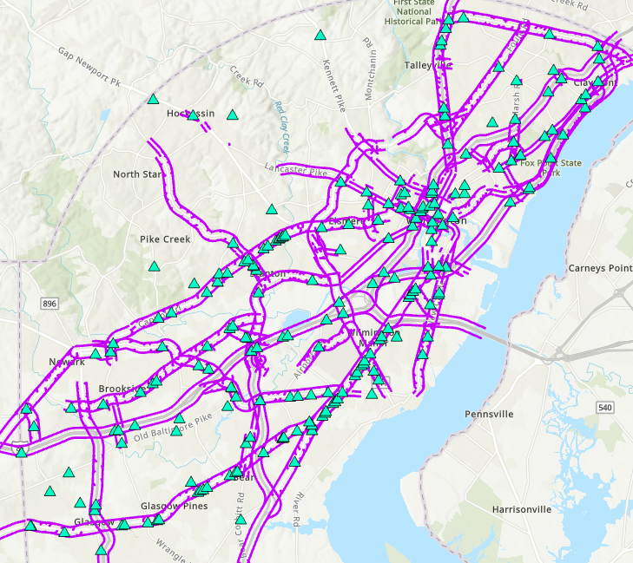
Fatal Crashes Shown With 4 Lane and Above Highways
Pedestrian and Bicyclist Involved

Slide 9
Major Factors Influencing Crashes
Speed
Travel Way Features
Number of Lanes
Access points
Facilities
Exposure – number of interactions, number of vehicles or pedestrians, volume
Land use
Driver
Environment

Slide 10
Any one of these factors would not necessarily indicate a high percentage of fatalities

Slide 11
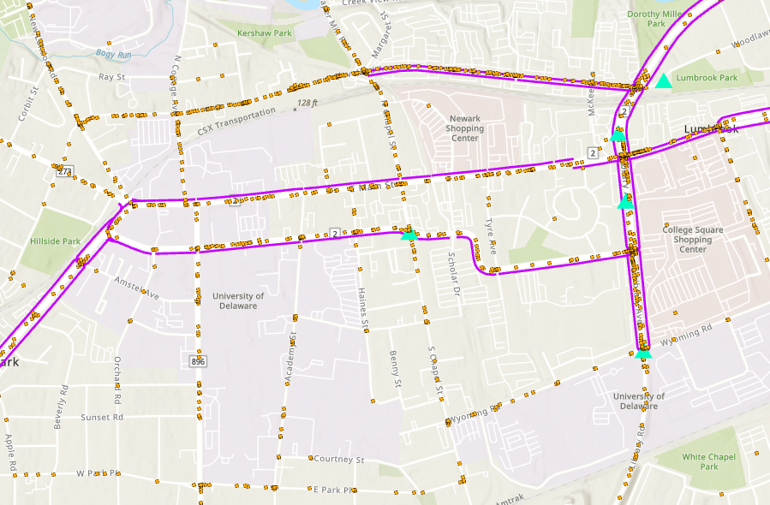
Exposure – Interactions
Many interactions in Newark and other urban areas but not a lot of fatalities

Slide 12
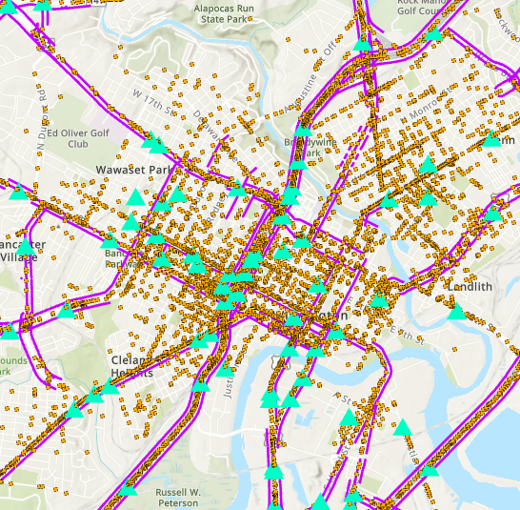
Exposure – Interactions
Many crashes but not fatalities

Slide 13
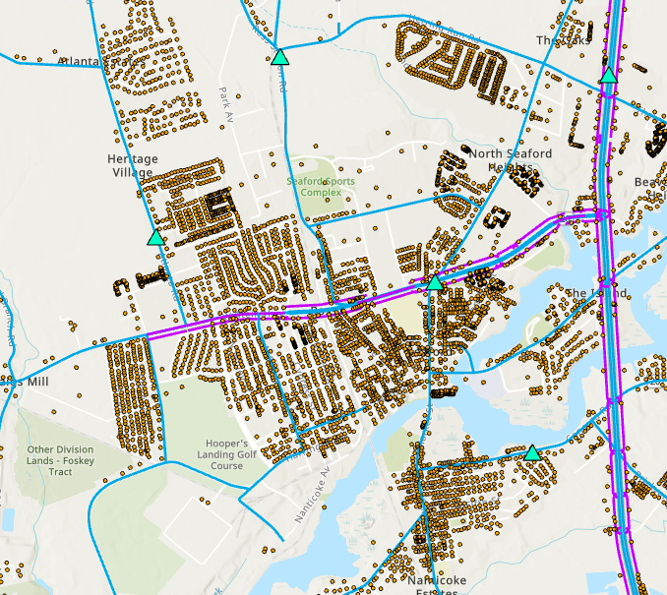
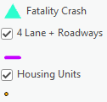
Access Points
Large access to major roads but low fatalities
Seaford

Slide 14
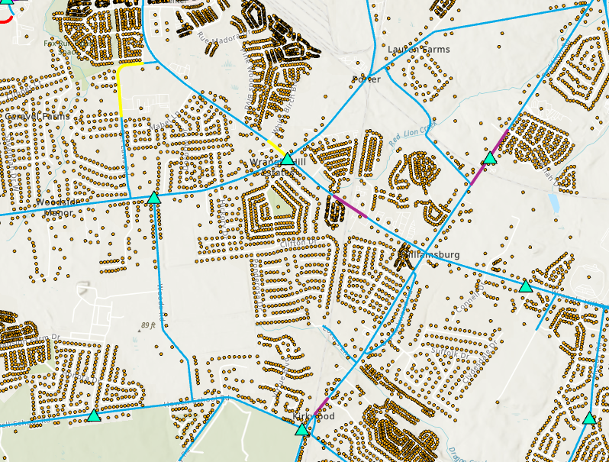
Access Points
Large housing unit access to major roads but low fatalities
Wrangle Hill

Slide 15
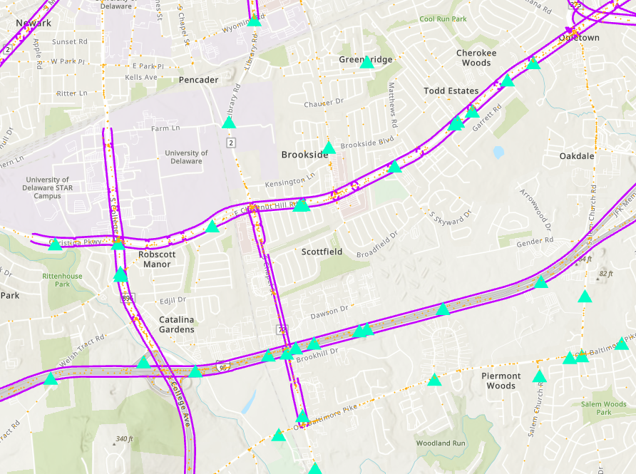
I
Volume and Speed
I95 compared with
Rt 4
Several times the amount of traffic on I-95 but similar number of fatalities.

Slide 16
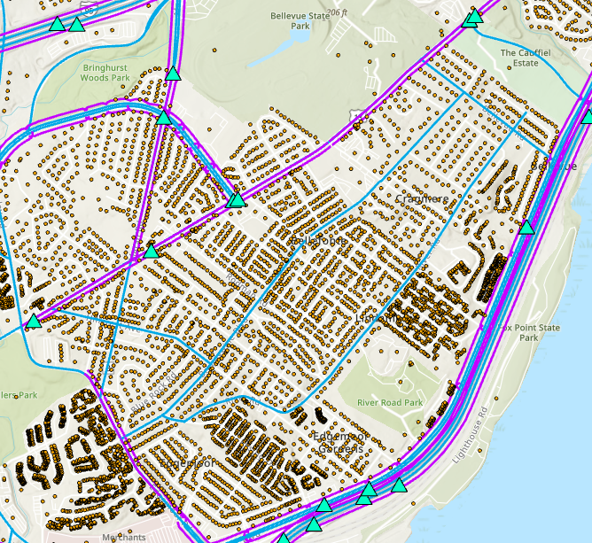
Volume and Speed
Rt 495 compared with Philadelphia pike
Bellfonte

Slide 17
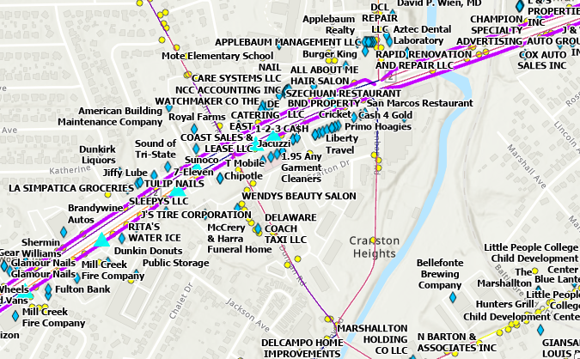
Destinations Used Here

Slide 18
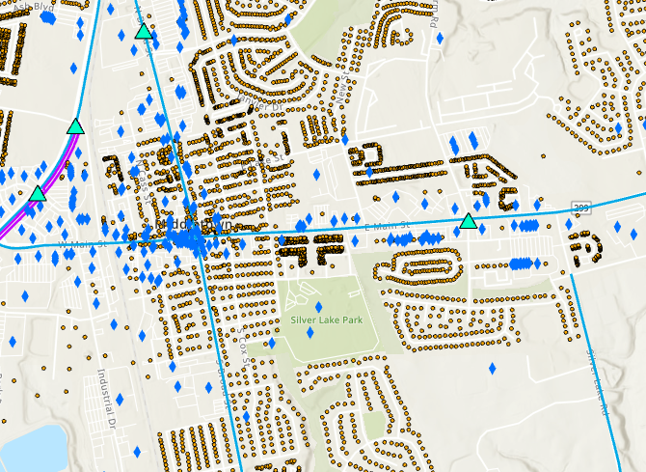
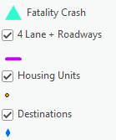
Highly mixed land use and low fatalities.
Middletown

Slide 19
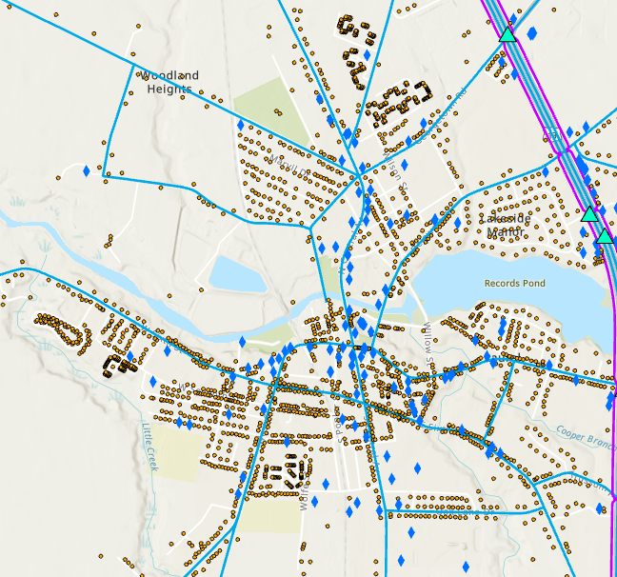
Highly mixed land use and no/low fatalities
Laurel

Slide 20
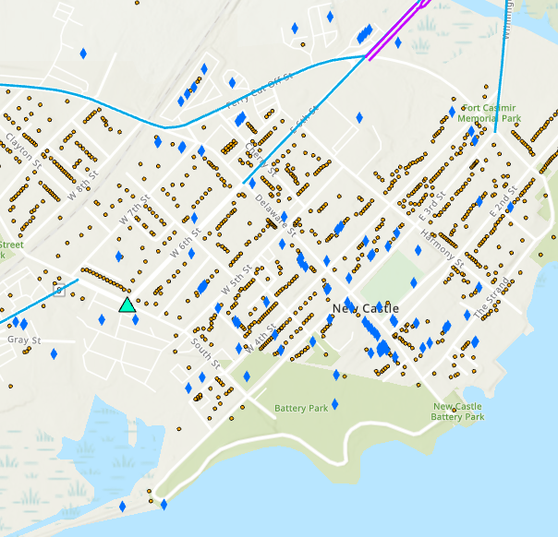
Highly mixed land use and no/low fatalities
City of New Castle

Slide 21
A "stroad" is a concept that groups factors related to higher incidence of fatalities, where a travel way is functioning as a major high speed, high volume corridor while at the same time having high access to neighboring land use. A highway functioning as a high access point to local residences and destinations.

Slide 22
An interesting view of daily trips as production and attraction of trips is provided by the DelDOT Travel Demand Forecasting Model. Maps that follow show traffic zone level trip productions with destination points.

Slide 23
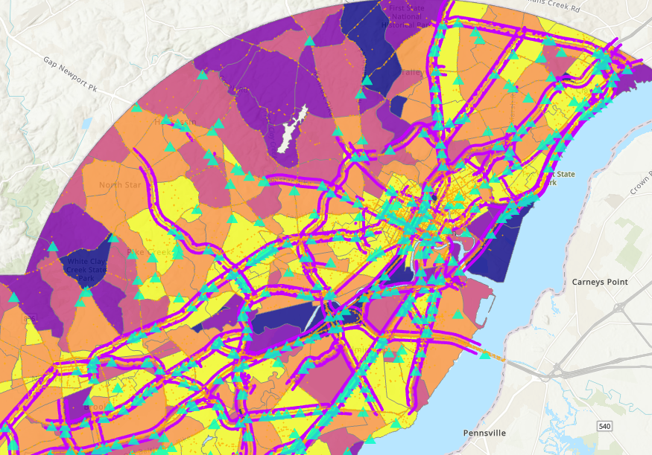
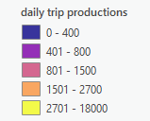
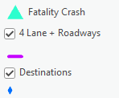

Slide 24
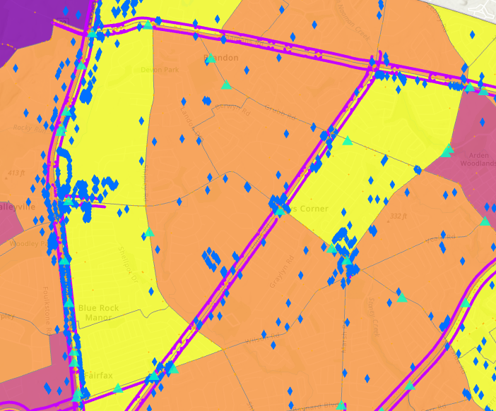
North Wilmington
Concord Pike and Foulk Road

Slide 25
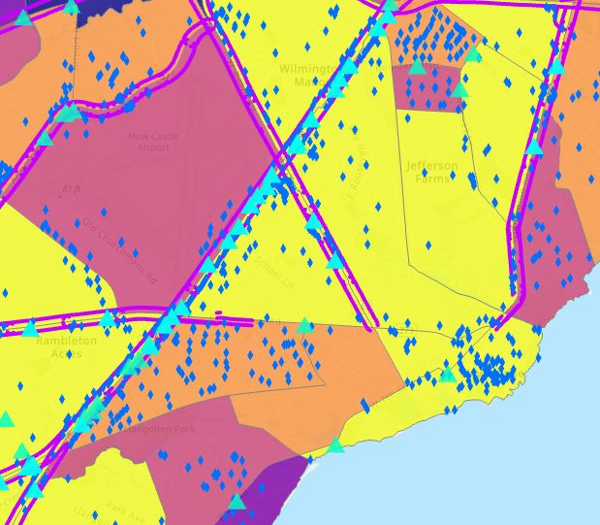
New Castle

Slide 26
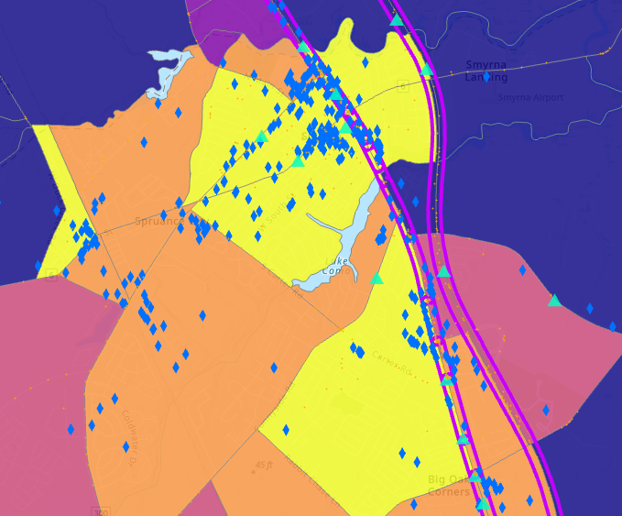
Smyrna

Slide 27
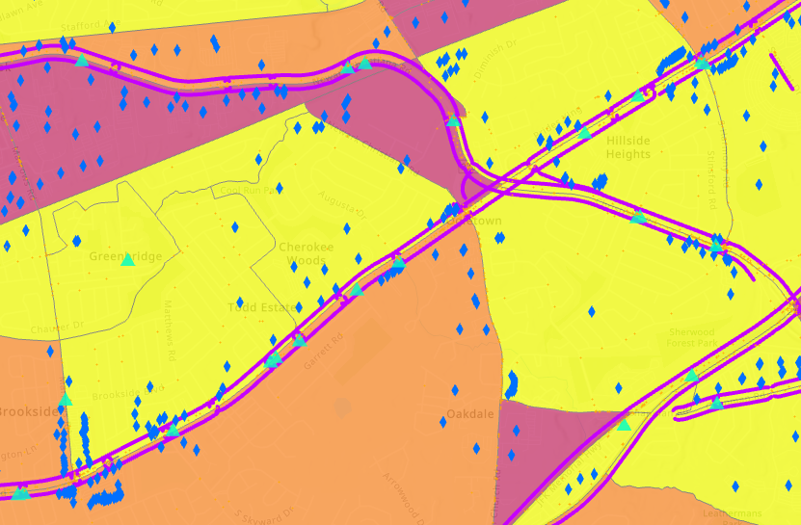
Route 4

Slide 28
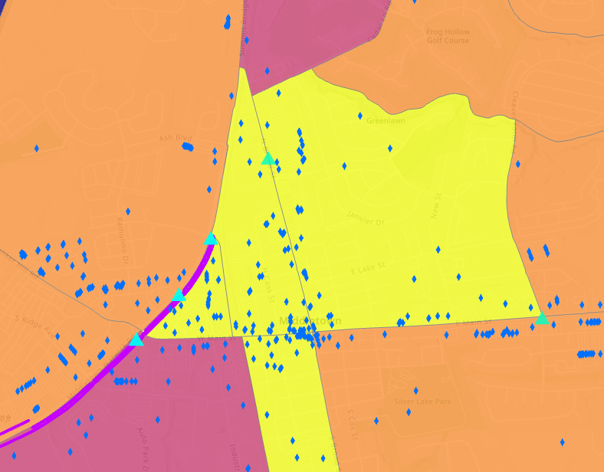
Middletown

Slide 29
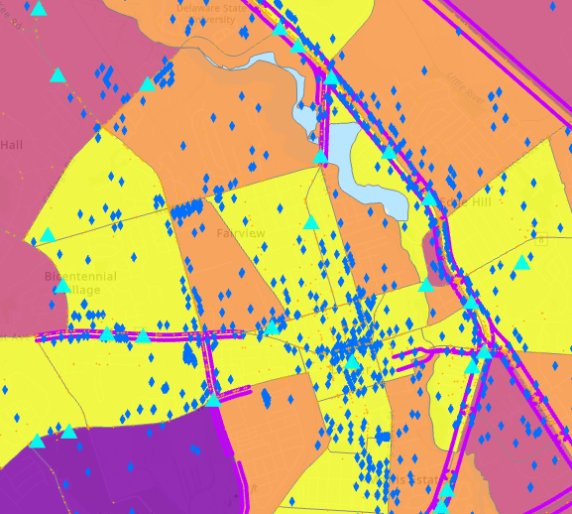
Dover

Slide 30
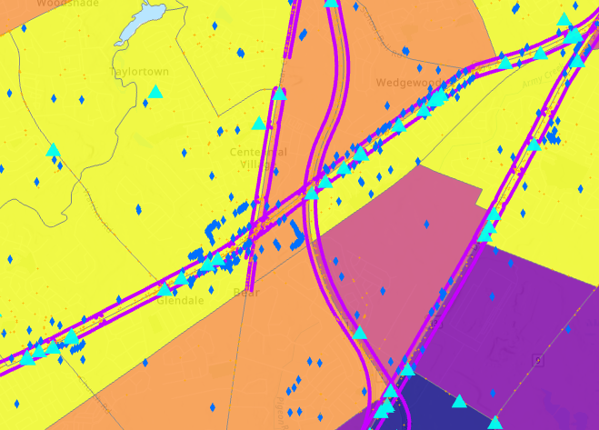
Route 40

Slide 31
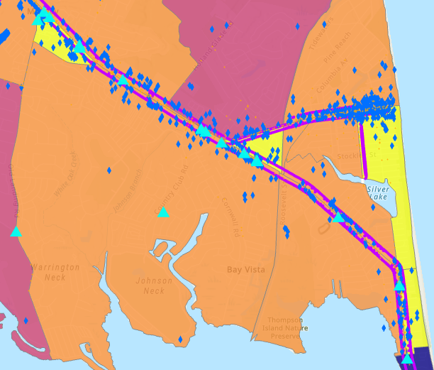
Route 1 into the beaches

Slide 32
Stroads could be mapped from the coincidence of:
multi-land highways,
destination clusters
the highest quartile of residential trip productions.
That would look like the following maps.

Slide 33
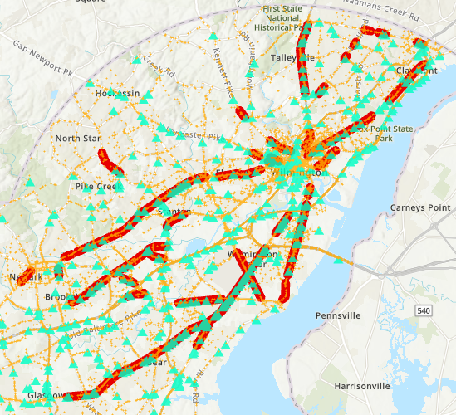

Slide 34
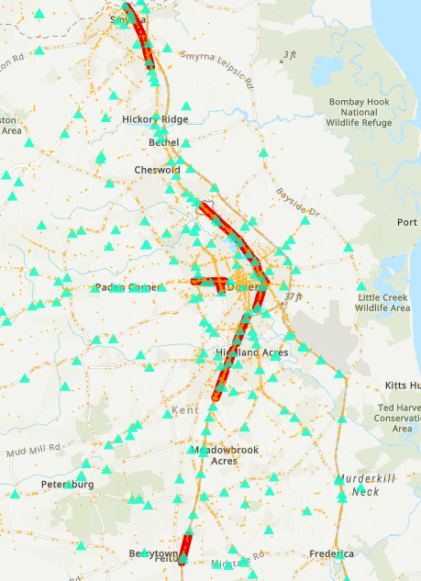

Slide 35
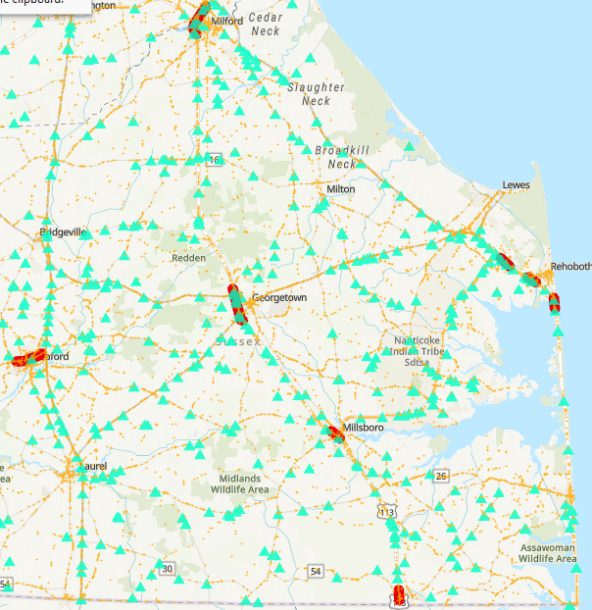

Slide 36
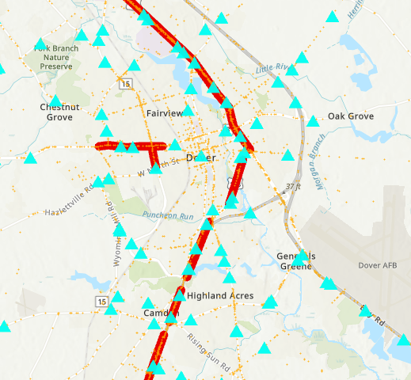
Dover

Slide 37
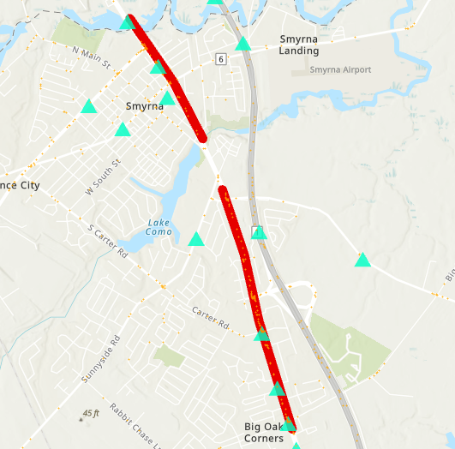
Smyrna

Slide 38
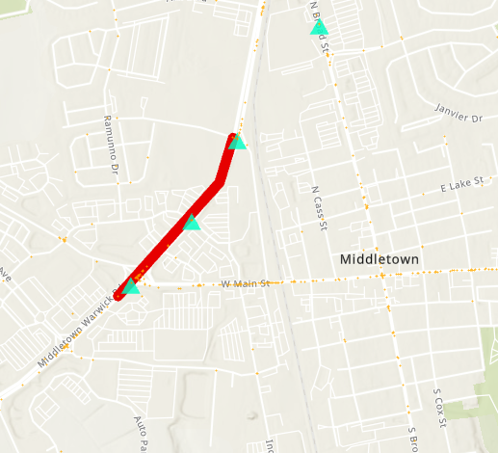
Middletown

Slide 39
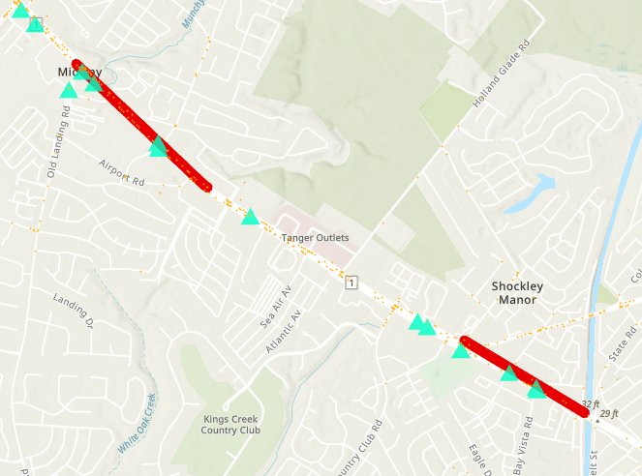
Route 1
Into Beach
Area

Slide 40
With this approach to identifying stroads that would be about 90 miles of stroad, close to 2% of major roads in Delaware.
About 15% of the fatalities occur on stroads as defined this way. Several times the percentage of major roads.
About 27% of fatalities occur on stroads when just looking at crashes involving pedestrians or bicyclists

Slide 41
A more specific Stroad definition might be:
Four or more lane highway
And an Access measure involving something like:
Number of driveways/access roads per mile
Number of housing units and destinations
Number of trips entering and exiting per mile
This could get more detailed as in the next slide that illustrates a housing unit and tax parcel level approach to defining the access. The result might not show an appreciable difference.

Slide 42
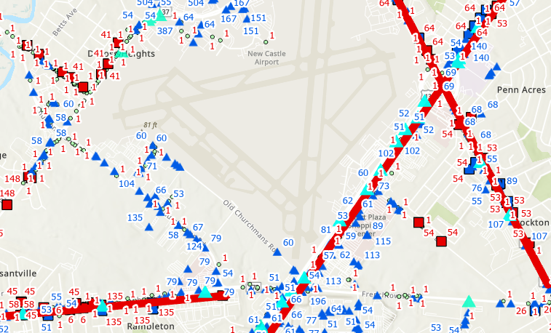
Total Housing units accessing at the points in the major road are in Red. Figures in Blue of what total attractions might look like and are not representative or accurate. Total attractions at this level have not been estimated.

Slide 43
In looking at the mapping a few other considerations stand out.
For instance, destinations clusters sometimes are set back within parking areas rather than having many destinations directly on the road and this would appear to be a safer configuration. Christiana Mall and perhaps Brandywine Town Center could be an example of this.
A traffic zone view does not fully capture access to major roads. For instance, the housing/productions could be set back from the major roads.

Slide 44
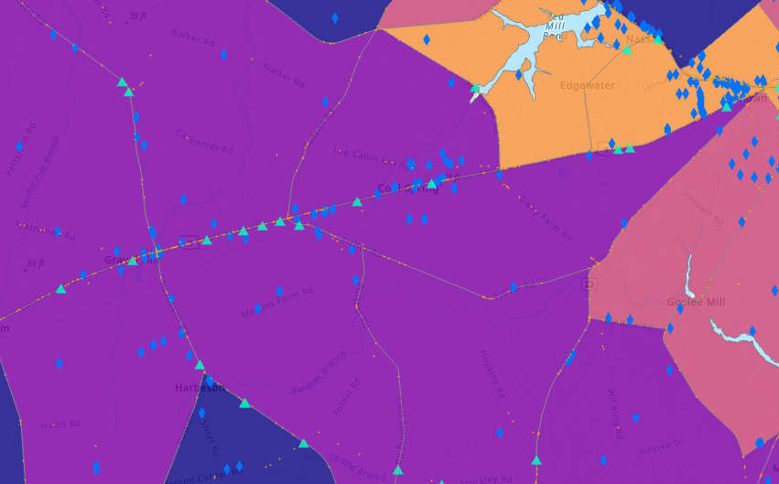
There are some major roads that show fatalities that wouldn’t be classified as a stroad, as with Route 9 in Sussex.

Slide 45
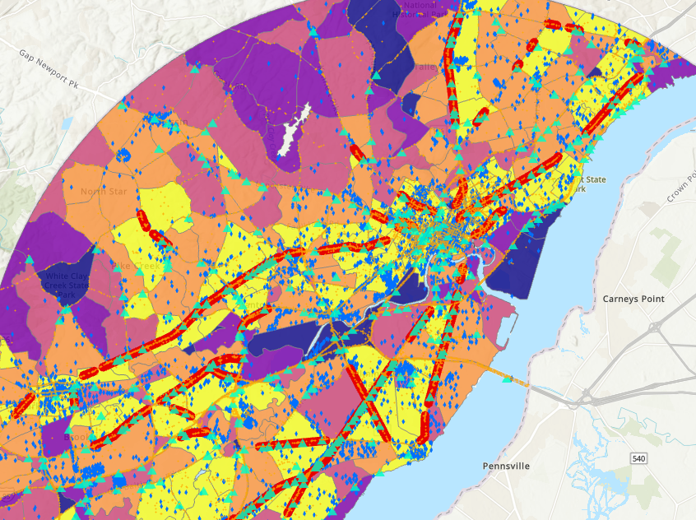
Questions?

